Slide 1
Estimation and forecasting for time series models
Eric Ward
FISH 507 – Applied Time Series Analysis
12 January 2017

Slide 2
Topics Week 2
Summarizing ARIMA models
Maximum Likelihood and Bayesian Estimation
Prediction & forecasting
Evaluating forecasts

Slide 3
Review: ARMA models
A time series is autoregressive moving average, or ARMA(p,q), if it is stationary and
AR processes in biology generally arise from lagged impacts, e.g. the effect of population size on population growth rates
MA processes describe how random ‘shocks’ or differences between predictions and observations propagate through time – including unknown external drivers, species interactions, etc

Slide 4
Biological time series are relatively short
We should only be using lower-order ARMA models with < 40 data points (Ives et al. 2010)
Examples:
ARMA(1,1): tree rings, Woollon & Norton 2003
ARMA (1,1): Vucetich et al. 1997 Cons Bio (moose in ISRO)
ARMA(2,2): fire dynamics, Beckage & Platt 2003
ARMA(2,1): Norwegian cod, Stinseth et al. 1999

Slide 5
Visualizing AR & MA processes
What’s the order of the AR() and MA() processes?
Notes:
set.seed(2)
e = rnorm(100,0,0.1)
# AR process
x.ar = 0
for(i in 2:100) {
x.ar[i] = 0.5*x.ar[i-1] + rnorm(1,0,0.1)
}
# MA process
x.ma = 0
for(i in 2:100) {
x.ma[i] = 0.5*e[i-1] + e[i]
}
plot(x.ar,type="l", lwd=3,lty=1,xlab="Time",ylab="Abundance",cex.axis=1.5,cex.lab=1.5,main="Can you spot which of these is AR vs MA?")
lines(x.ma,type="l",lwd=3,col="red",lty=1)

Slide 6
Remember Mark’s lecture: use ACF & PACF for model ID
 | ACF | PACF
AR(p) | Tails off | Cuts off after lag-p
MA(q) | Cuts off after lag-q | Tails off
ARMA(p,q) | Tails off (after lag [q-p]) | Tails off (after lag [p-q])

Slide 7
This is an AR(1) and MA(1) model

Slide 8
Topics Week 2
Summarizing ARIMA models
Maximum Likelihood and Bayesian Estimation
Prediction & forecasting
Evaluating forecasts

Slide 9
Maximum Likelihood
A priori, we specify that the data (or some process) has been generated from a distribution (e.g. Normal)
The likelihood of data x₁, x₂, x₃, can then be calculated
R provides built in functions for doing this: dnorm(), dpois(), dbinom(), dgamma(), etc.

Slide 10
Interpretation of maximum likelihood
When we write the likelihood, the parameters are conditioned on the data.
“What’s the likelihood of the parameters given the data?”
Parameters are fixed quantities, data are random

Slide 11
Goal: find parameters that maximize likelihood
Parameters that maximize the likelihood will also maximize the log-likelihood
Equivalently, we can minimize the negative log-likelihood
Example: generate random walk with drift
Stochastic model aka “process error model”
set.seed(1)
e = rnorm(100,0,1) # white noise ~ Normal(0,1)
x = 0 # initial value
for(i in 2:100) {x[i] = x[i-1] + 0.1 + e[i]}

Slide 12
The Data

Slide 13
Steps to find MLE
Write a function that takes in parameters, and returns NLL (= Negative log likelihood)
rwdrift = function(pars) {
# pars[1] = drift, pars[2] = error
drift = pars[1]
sigma = exp(pars[2]) # trick to keep positive
predx= 0
for(i in 2:100) {
predx[i] = x[i-1] + drift
}
logLike = sum(dnorm(x[2:100], predx[2:100], sd = sigma, log=TRUE))
return(-logLike) # return NLL because optim minimizes
}

Slide 14
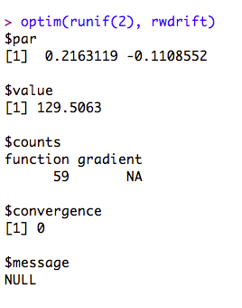
Use your favorite minimizer/maximizer
Even for 100 data points,
estimates of drift and error
variance aren’t perfect
optim() tells us that the algorithm
has converged at the MLE

Slide 15
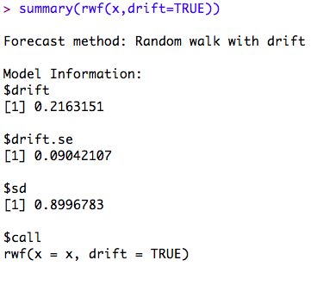
Other functions in R
Many existing functions we’re using – lm(), arima(), Arima(), MARSS(), are also using maximum likelihood
rwf() in ‘forecast’ does the exact same thing as our function ‘rwdrift’

Slide 16
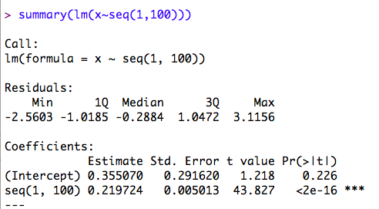
A second type of model we could fit would be fitting a regression line through the data?
Tiny bit different from the trend estimate
we got from rwf() –
Is this difference meaningful?
Any insight as to why they’re different?
What does this imply for predictions?

Slide 17
Regression is fitting a deterministic process through the data (all residual error = “observation error”)
Random walks are fitting a stochastic process (no observation error, all process variability)
In the lab, we’ll also introduce univariate ‘state-space’ models, which estimate both process and observation error variances

Slide 18
Bayesian Estimation
Subtle but important differences between maximum likelihood / Bayesian approaches
Bayesians also use likelihood, but view the data as fixed and the parameters as random
Bayesian
Maximum likelihood

Slide 19
Bayes Theorem
Based on laws of conditional probability
Using our previous notation & likelihood,
P(x) is a constant, and usually not written, so

Slide 20
Bayes Theorem
What are the components of this equation?
is the likelihood
is the prior probability distribution
is the posterior probability distribution

Slide 21
Why use a prior
Prior necessary to express the posterior as a probability distribution
It’s also expression of a priori belief
Posterior is thus a probability distribution
Difference between posterior and prior is a measure of how much you ‘learn’ by seeing data
Can also be thought of as weighted average of data + beliefs

Slide 22
Example
Notes:
r1 = rnorm(10000,3,10)
r2 = rnorm(10000,5,1)
r3 = rnorm(10000,4.5,1)
d1 = density(r1)
d1$y = d1$y/sum(d1$y)
d2 = density(r2)
d2$y = d2$y/sum(d2$y)
d3 = density(r3)
d3$y = d3$y/sum(d3$y)
plot(d1$x,d1$y, type="l", lty=1,lwd=3, col="red", xlim=c(0,8),ylim=c(0,0.008), xlab="Theta",ylab="Density")
lines(d2$x,d2$y, lty=1,lwd=3, col="blue")
lines(d3$x,d3$y, lty=1,lwd=3, col="purple")
legend('topleft', c("Prior", "Likelihood","Posterior"), col = c("red","blue","purple"),lwd=3, lty=1, bty='n')

Slide 23
Differences in estimation
Bayesian methods require evaluating the likelihood by integrating over the parameter space (instead of maximizing)
Fish 507: there are a handful of ways to do numerical integration. For this class, we’ll only use Markov Chain Monte Carlo (MCMC)
Sample sequentially 1000s of samples of parameter space

Slide 24
2D posterior surface: think about animal foraging on landscape
MLE is finding the
absolute best point.
Bayesian methods
attempt to find the best
point on average.
MLE
Posterior mode

Slide 25
Overview of MCMC
Simulate random walks over the parameter space, with a tendency to spend more time in areas of high likelihood
Each random walk = MCMC chain.
Each initialized from unique starting point
Each samples independently for 1000s of iterations
We’ll discard the first XX samples, as a “burn-in period”
Notes:
x1 <- rnorm(20000, mean = 3,sd=2)
y1 <- rnorm(20000, mean = 10, sd=2)
x2 = rnorm(20000, mean = 10, sd = 3)
y2 = rnorm(20000, mean = 2, sd = 3)
x = c(x1,x2)
y = c(y1,y2)
hist2d(x,y,nbins = 100, col = tim.colors(40))

Slide 26
MCMC convergence
Assessing convergence is more difficult than maximum likelihood
We’ll run through a couple diagnostics, but this is not comprehensize (Andre’s 507 dives into this more)

Slide 27
We need chains to be stationary
Notes:
par(mfrow = c(3,1))
x = rnorm(10000) + seq(1,10000)*0.0005
y = c(rnorm(5000),rnorm(5000,0.3,0.7))
z = rnorm(10000)
par(mfrow =c(3,1))
plot(x,type="l",ylab="",xlab="")
abline(0,0,col="red",lwd=2)
plot(y,type="l",ylab="",xlab="")
abline(0,0,col="red",lwd=2)
plot(z,type="l",ylab="",xlab="")
abline(0,0,col="red",lwd=2)

Slide 28
We want each sample to be approximately independent
If lag(1) acf is too high, increase the ‘thinning rate’ of the MCMC chain

Slide 29
Quantitative tests of convergence
Gelman-Rubin diagnostic
Used to check convergence of multiple chains in parallel. Goal: R_hat in (1.0, 1.05)
Geweke diagnostic
Is mean of first 10% of MCMC chain the same as the last 50%?
Heidelberger-Welch diagnostic
Is the entire chain stationary? If not, is the last 90%? 80%? 70%? Etc.

Slide 30
Topics Week 2
Summarizing ARIMA models
Maximum Likelihood and Bayesian Estimation
Prediction & forecasting
Evaluating forecasts

Slide 31
Forecasting
We’ll use the word forecasting to refer to out of sample prediction
Consider the following 2 basic models
Linear regression
Random walk
What can you say about their predictions – or where their errors are coming from?
Linear regression errors = observation, random walk errors = process

Slide 32
predict() function
After fitting a regression model, we can use predict() or predict.lm()
Example

Slide 33
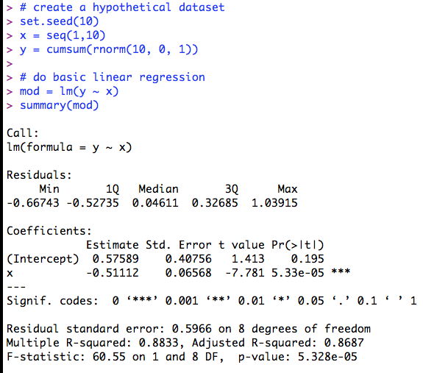

Slide 34
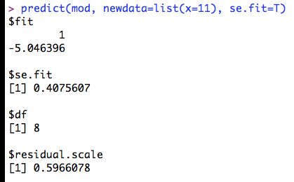
If we apply predict() with default arguments, our prediction se is smaller than the residual error!

Slide 35
Confidence v Prediction Intervals
Confidence intervals on the mean (in-sample)
predict(mod, newdata=list(x=11), se.fit=T, interval="confidence")
Confidence intervals on the mean (in-sample)
Interval = (-5.99, -4.10)
Prediction intervals should be used for new observations (in or out of sample)
predict(mod, newdata=list(x=11), se.fit=T, interval=”prediction”)
Interval = (-6.71, -3.38)

Slide 36
Using gam() as forecasting model
gam() is in “mgcv”
More flexible than OLS regression
Non-linear
Non normal errors
Complexity can be captured via fitting a series of polynomial splines

Slide 37
Notes:
www = "http://www.massey.ac.nz/~pscowper/ts/global.dat"
Global = scan(www)
plot(ts(Global, st=c(1856,1), end= c(2005,12), fr=12), xlab="Time", ylab= "Global temperature”)

Slide 38
Notes:
www = "http://www.massey.ac.nz/~pscowper/ts/global.dat"
Global = scan(www)
plot(ts(Global, st=c(1856,1), end= c(2005,12), fr=12), xlab="Time", ylab= "Global temperature")
time = seq(1856,2005.917,by=1/12)
lin.mod = lm(Global~time)
lines(time, lin.mod$fit, lty=1,lwd=4,col="red")

Slide 39
Adj R-Sq = 0.54
Adj R-Sq = 0.69
Notes:
www = "http://www.massey.ac.nz/~pscowper/ts/global.dat"
Global = scan(www)
plot(ts(Global, st=c(1856,1), end= c(2005,12), fr=12), xlab="Time", ylab= "Global temperature")
time = seq(1856,2005.917,by=1/12)
lin.mod = lm(Global~time)
lines(time, lin.mod$fit, lty=1,lwd=4,col="red")
gam.mod = gam(Global ~ s(time))
lines(time, gam.mod$fit, lty=1,lwd=4,col="blue")

Slide 40
Predictions from GAMs
predict(gam.mod,newdata=list(time=2006),type="terms",se=TRUE)
type = “terms” only includes uncertainty in spline terms
type = “iterms” or “response” will make se.fit larger because it includes uncertainty in intercept

Slide 41
Forecasting with arima()
Let’s fit an ARMA(1,1) model to the global temperature data, after 1st differencing to remove trend
You can use the arima() function or Arima() function – Arima() is a wrapper for arima()
# for simplicity, we won’t include a separate ARMA model for seasonality
ar.global.1 = Arima(Global, order = c(1,1,1),seasonal=list(order=c(0,0,0),period=12))
f1 = forecast(ar.global.1, h = 10)

Slide 42
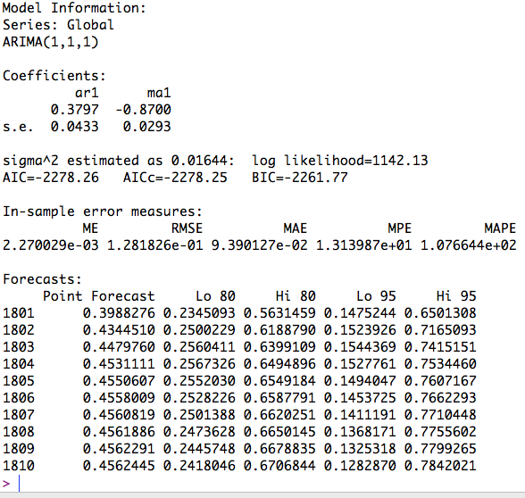
What does f1 contain?

Slide 43
plot fitted arima() object

Slide 44
Summary
As expected, uncertainty increases as a function of forecast length
We could also perform forecasts by bootstrapping new values of arima() parameters
Bayesian forecasts are very similar
Forecasts can be made based on the mode, HPD region, or for all MCMC samples

Slide 45
With lab
Practice using arima.sim () to simulate time series of different AR and MA orders

